Slide 1
Java Messaging Service(JMS) - Queues and Topics
Each JMS message sent by an application is addressed with a destination.
Destinations in JMS are like postal mailboxes where the messages are placed until someone comes to pick them up.
There are two types of destination in JMS: queues and topics.
Destination
Queues
Topics

Slide 2
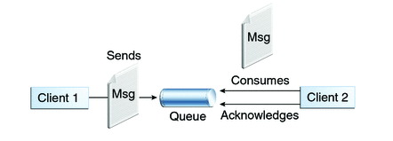
Java Messaging Service(JMS) - Queues and Topics
Queues [point-to-point]:
Queue’s are based on point-to-point messaging model where messages are sent to a queue.
Each message has exactly one sender and one receiver.
Message is guaranteed to be delivered to only one receiver.

Slide 3
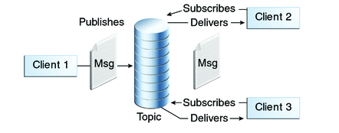
Java Messaging Service(JMS) - Queues and Topics
Topics [publish-subscribe]:
Topic’s are based on publish-subscribe model where messages are sent to a topic.
N subscribers can be subscribed on a topic, and when a message arrives, each will get a copy of that message.

